Slide 1
The HotCiv GUI
Instantiating the
MiniDraw Framework

Slide 2
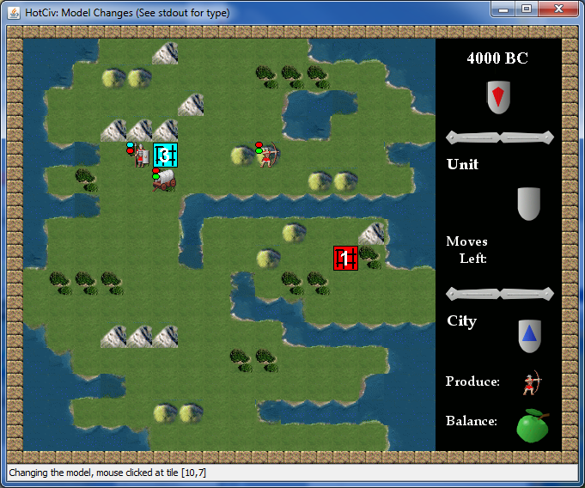

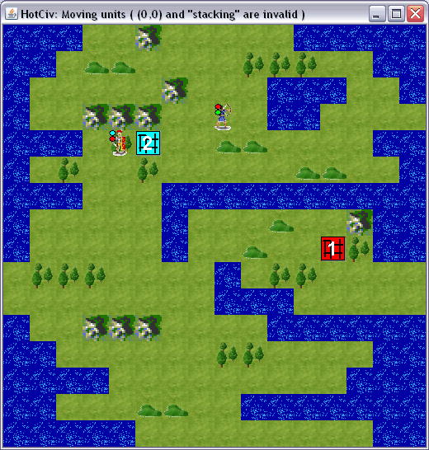
[Demo]
CS @ AU
Henrik Bærbak Christensen
Notes:
Ant update

Slide 3
The Framework iteration
Learning Objectives:
  Frameworks:
    Configure/specialize MiniDraw to support HotCiv GUI
    See MiniDraw as example of a framework
    See a lot of patterns in action
  TDD and Stubs
    You can develop the GUI the TDD way
      Keep focus & take small steps
      No automated testing though...
    You can develop the GUI based only on stubs
CS @ AU
Henrik Bærbak Christensen

Slide 4
The Exercise Sequence
Basically TDD iterations
  36.37: Observer on Game
  36.38: Create a new Drawing that responds to Game state changes using the observer
    Game → GUI integration
  36.39: Create a Tool to move units
    GUI → Game integration
  36.40 – 36.44: Create tools to do all the other stuff
    End of turn, change production, execute unit action, ...
i.e. Add features in fast focused iterations...
CS @ AU
Henrik Bærbak Christensen

Slide 5
Patterns for Integration

Slide 6
The design
Proper design pattern protocols
  Facade pattern [GUI inform Domain]
  Observer pattern [Domain inform GUI]
  only rely on interfaces
    I can develop the GUI using Stub implementations of the Domain’s Facade and Observer roles
      Facade = Interface Game
      Observer = Interface GameListener
  reuse MiniDraw’s graphical abilities
    let someone else do the dirty job...
CS @ AU
Henrik Bærbak Christensen

Slide 7
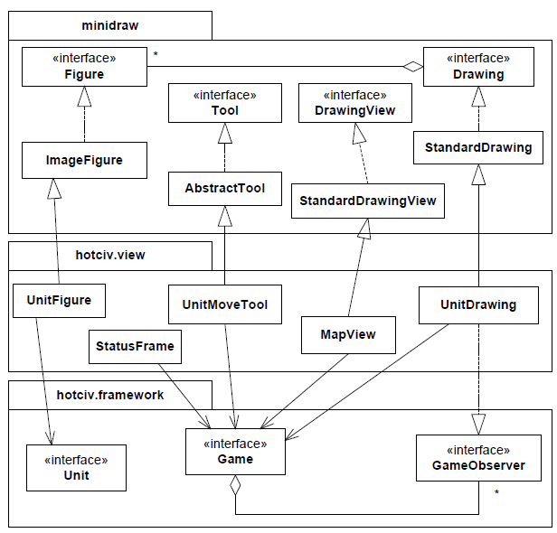
GUI
Three layers
MiniDraw
hotciv.view: HotSpots
for figures, tools, drawing and
Drawingview etc
Civ
Your production code
CS @ AU
Henrik Bærbak Christensen

Slide 8
Central Protocol
The protocol between GUI and Domain:
  GUI ⇒ Domain
    Facade pattern (Game interface)
    MVC + Adapter:
    A tool translate mouse clicks to proper method
      UnitMoveTool: ‘moveUnit’
      StatusTool: ‘getCityAt’…
  GUI ⇐ Domain
    Observer pattern (GameObserver interface)
    Drawing must react upon events from domain
      worldChangedAt()
CS @ AU
Henrik Bærbak Christensen

Slide 9
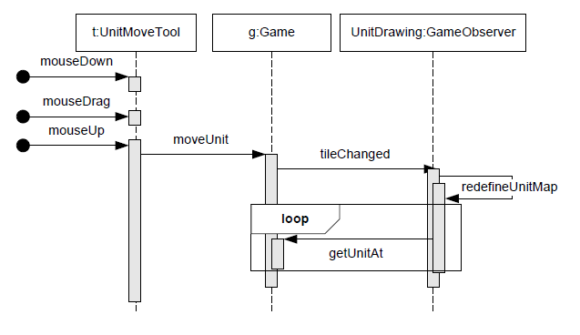
Example: Moving Units
Moving units means invoking game’s “moveUnit”
The special dSoftArk provided code implements this
Civ
worldChangedAt
boardIterator
CS @ AU
Henrik Bærbak Christensen

Slide 10
Example: Moving Units
Facade
Observer
worldChangedAt
GUI ⇒ Domain ⇒ GUI
CS @ AU
Henrik Bærbak Christensen

Slide 11
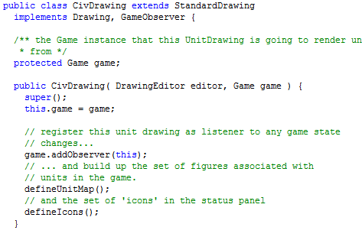
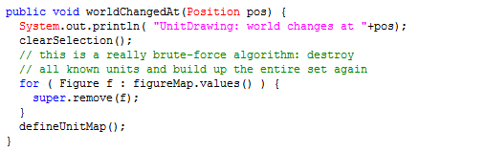
Code View
Brute-force
redrawing ☺
A compositional refactoring pending...
CS @ AU
Henrik Bærbak Christensen

Slide 12
Testing without production code?
The GUI can be completely developed without any real domain production code
  no Alpha, ..., Delta, nor SemiCiv
Why?
  Because I program to an interface!
  Game g = ?
  g.moveUnit( ... );
  g.endOfTurn();
CS @ AU
Henrik Bærbak Christensen

Slide 13
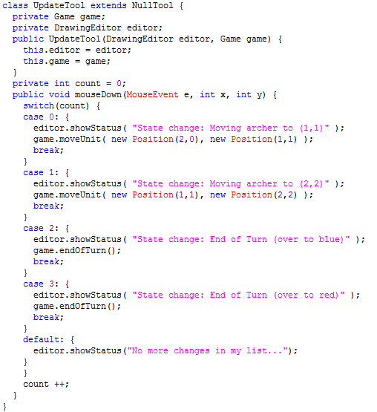
Example: 36.38
Goal: Implement CivDrawing
  Responsibility:
  update graphics upon game state changes
A testing tool to trigger game state changes
CS @ AU
Henrik Bærbak Christensen

Slide 14
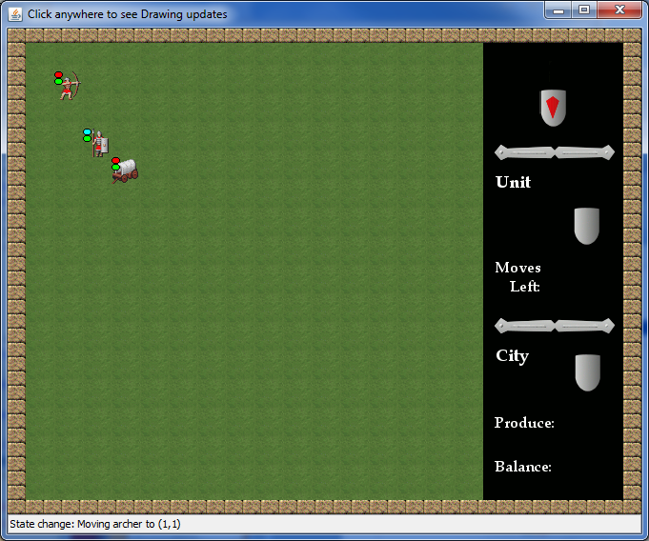
Demo: ant update
CS @ AU
Henrik Bærbak Christensen

Slide 15
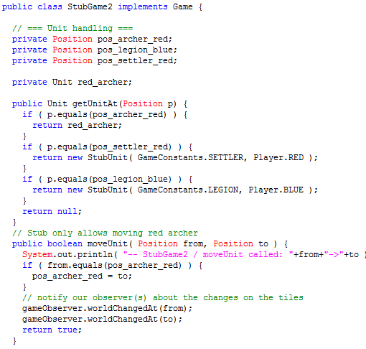
Test Stubs
Game implementation?
  Complete façade, has not sub-objects
  Units: only three
  moveUnit: only moves red archer…
Conclusion: simple code
But
  Sufficient for our sprint goal: to develop the CivDrawing that responds to unit moves, etc.
CS @ AU
Henrik Bærbak Christensen

Slide 16
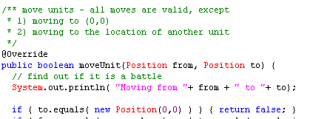
Test Stubs
Requirement:
  Enough to test all GUI related behaviour
  Example
    Must be able to GUI’s behaviour for illegal moves – therefore some moves must be invalid!
CS @ AU
Henrik Bærbak Christensen

Slide 17
What about TDD
Can I develop the GUI by TDD?
  Yes: Define a test first, like
    “MapView”: OneStepTest: draw the world…
    “TestModelUpdate”: see game state changes reflected
    ...
    and then implement the proper MiniDraw role implementations that makes this happen!
  No: I cannot make it automated as I have to visually inspect the result to verify behaviour
    but manual tests are better than no tests!!!
    especially when I refactored the damn thing to use MiniDraw instead of JHotDraw !!!
CS @ AU
Henrik Bærbak Christensen

Slide 18
TDD note
The Tool abstraction comes in very handy for testing!
  Define a testing oriented tool that force some behaviour directly
Example:
  TestPartialDrawing
    drive the implementation of the GUI responding correctly on updates from the Domain
  That is: when I click with the mouse, make a state change and start the observer protocol update chain…
CS @ AU
Henrik Bærbak Christensen

Slide 19
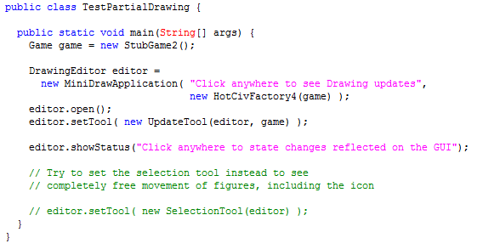
On-the-spot Tools
CS @ AU
Henrik Bærbak Christensen

Slide 20
Test Target Demo
[Demo]: “update”
  Note archer movement
  Note also blue city
  Note status field
CS @ AU
Henrik Bærbak Christensen

Slide 21
My Own Sprints
Map (target ‘show’)
  Draw a graphical world (background for figures)
  DrawingView implementation (MapView)
Unit (target ‘update’)
  Draw units correctly positioned (Figures)
  UnitFigure and CivDrawing
    MiniDraw delegate all ‘model’ responsibilities to a Drawing instance. Therefore MiniDraw does not detect that CivDrawing simply brute-force erase and create lists of figures on each Game state change!
Update (target ‘update’)
  CivDrawing becomes observer on Game
CS @ AU
Henrik Bærbak Christensen

Slide 22
Own Sprint
Move (target – is mine ☺)
  Moving graphics means moving units in Game
  UnitMoveTool, a new Tool
CS @ AU
Henrik Bærbak Christensen

